Slide 1


G-Miner
An Efficient Task-Oriented Graph Mining System
Hongzhi Chen, Miao Liu, Yunjian Zhao
Xiao Yan, Da Yan, James Cheng

Slide 2
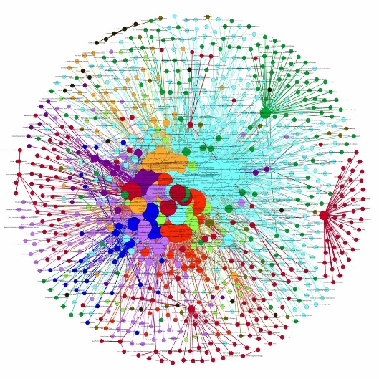
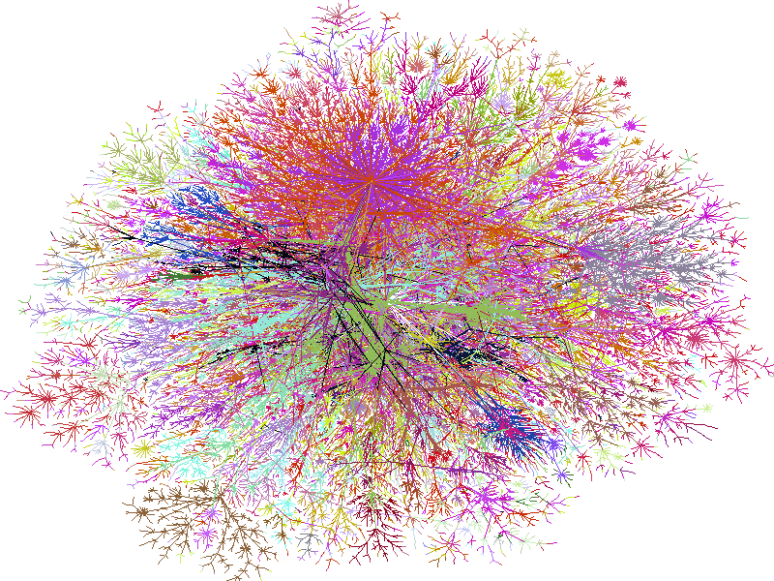
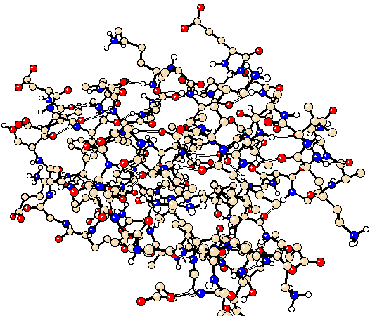
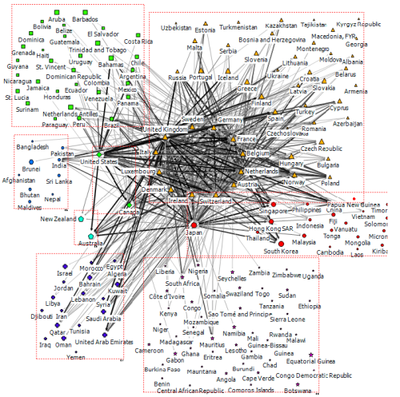
Graph Data are Everywhere
Social Networks
Products/Friends recommendation
User actions capture
Semantic Webs
Real-Time hot-topics tracking
Semantic analysis/prediction
Biological Networks
DNA sequencing
Diseases diagnosis
Financial networks
Market forecasts
Stock analysis

Slide 3
The development of Parallel Graph Processing
Dozens of Parallel Graph Processing Systems proposed in recent years
Vertex-Centirc [most popular one]
“Think as a Vertex” model
Computing Unit = Vertex
Each vertex holds a local status
Examples:
Pregel [SIGMOD’08], PowerGraph [OSDI’12], GPS [SSDBM’13],
GraphX [OSDI’14], Pregel+[WWW’15], GraM[SoCC’15],
PowerLyra [EuroSys’15], etc.

Slide 4
The development of Parallel Graph Processing
Dozens of Parallel Graph Processing Systems proposed in recent years
Edge-centric [single machine]
“Think as a Edge” model
Computing Unit = Edge
Regards graph as streaming edge lists
Examples:
GraphChi [OSDI’12], X-stream [SOSP’13],
GridGraph [ATC’15], Mosaic [EuroSys’17]

Slide 5
The development of Parallel Graph Processing
Dozens of Parallel Graph Processing Systems proposed in recent years
Graph-centric
“Think as a Subgraph” model
Computing Unit = Vertex
Communication Unit = Subgraph/Block
Reduce the #Msgs and #Supersteps

Slide 6
What existing graph systems are good at?
Graph workloads can be very different
Most systems aim at graph algorithms with the following characteristics:
Most or all vertices will be active at each iteration
The computational cost on each vertex is light, e.g.:
sum(msgs)
min(msgs)
max(msgs)
The communication and memory usage are linear/superlinear with |E|
Examples:
PageRank
Connected Components
SSSP
…

Slide 7
Characteristics of Graph Mining algorithms
Graph workloads can be very different
Graph Mining Algorithms
Frequent Subgraph Mining
Community Detection
Graph Matching
Graph Clustering
…
Not all vertices actice, only partial interested ones
Graph mining workload is much more computation-intensive and/or memory intensive
superlinear or even exponentially
the well-known combinatorial explosion problem

Slide 8
Characteristics of Graph Mining algorithms
a single-thread implementation of Max-Clique Finding , running on a high-end server on 4 graphs
Dataset | Skitter | Orkut | BTC | Friendster
|V| | 1,696,415 | 3,072,441 | 164,732,473 | 65,608,366
|E| | 11,095,298 | 117,184,899 | 386,411,047 | 1,806,067,135
Data Size | 165 MB | 1.80 GB | 9.14 GB | 32.83 GB
Time | 14h29min | 24h04min | > 72h | >72h
Mem. | 2.60 GB | 24.42 GB | 116.53 GB | 385.00 GB
Table 1: Performance of single-thread max-clique finding algorithm on a high-end server
Characteristics of graph mining workload revealed:
High memory consumption
High CPU overhead

Slide 9
Characteristics of Graph Mining algorithms
Max-Clique Finding on 4 existing distributed graph systems
System | Cores | Mem. (GB) | Net. (GB) | CPU Util. | Time (s) | Note
Arabesque | #24 x 8 | 268.43 | 39.87 | 74.25% | - | Run over 24h.
Giraph | #24 x 8 | NA | 26.81 | 43.25% | x | OOM.
GraphX | #24 x 8 | 277.71 | 27.14 | 11.58% | - | Run over 24h.
G-thinker | #24 x 8 | 66.68 | 36.75 | 16.20% | 164.6 | Succeed.
Table 2: Performance of distributed max-clique finding on 4 state-of-the-art systems
(“-": >24 hours; “x": job failed as out of memory) for Orkut
The performance of the 4 existing distributed systems:
Most of them have low CPU utilization
Serious OOM issue
Long execution time

Slide 10
Characteristics of Graph Mining algorithms
The limitations of existing graph systems for graph mining
Mismatch of computational model
The synchronization barrier ➔ Straggler problem
A fine-grained model (e.g. vertex-centric) is inefficient
Hard to express the graph mining algorithms
…
No bound on memory usage
No optimization for CPU utilization

Slide 11
Our Contributions
G-Miner: a distributed task-oriented system specialized for solving graph mining problems on large-scale graphs.
Task model
Task pipeline
Memory bound
Two graph-mining specific strategies for load balancing
BDG partitioning
Task stealing
Optimizations to further improve the scalability

Slide 12
Outlines
Task Model
Task-Pipeline
System Architecture
Load Balancing
G-Miner API
Evaluation

Slide 13
Task Model
General Graph Mining Schema
G-Miner aims to provide a unifed programming framework for implementing a wide range of graph mining algorithms.
We first identify a common pattern for existing graph mining algorithms.
Five categories for typical graph mining problems:
Subgraph/graphlet enumeration (e.g., triangles, cliques)
Subgraph matching (i.e., listing all occurrences of a set of query subgraphs)
Subgraph finding (e.g., maximum clique finding)
Subgraph mining (e.g., frequent graph mining, community detection)
Graph clustering

Slide 14
Task Model
General Graph Mining Schema
A general computing schema:
init(): a graph mining job usually starting from a set of seed vertices selected by initial conditions
update(): then, recursively process on each subgraph g :
grow (by adding neighbor vertices)
shrink (by pruning some parts)
split (into more subgraphs)
delete or report

Slide 15
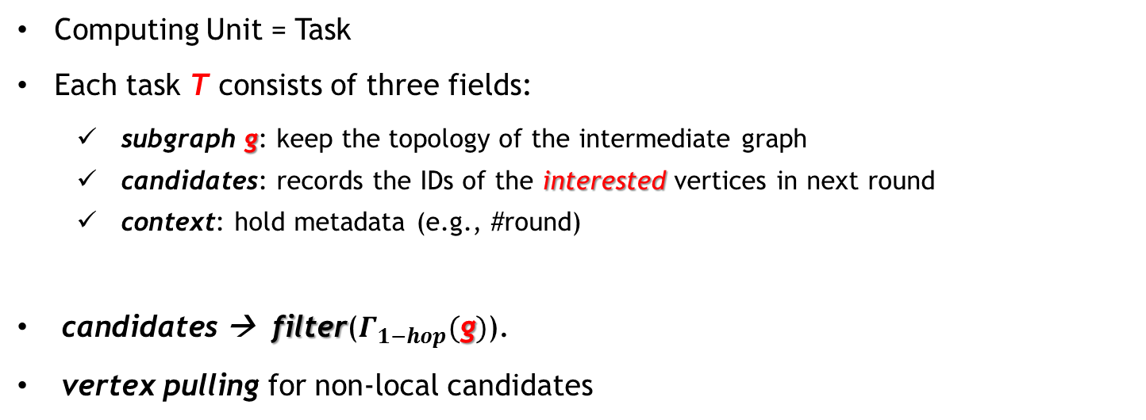
Task Model
Basic Concepts
Computing Unit = Task
Each task T consists of three fields:
subgraph g: keep the topology of the intermediate graph
candidates: records the IDs of the interested vertices in next round
context: hold metadata (e.g., #round)
candidates → filter($Γ_{1−hop}(\text{g})$).
vertex pulling for non-local candidates

Slide 16
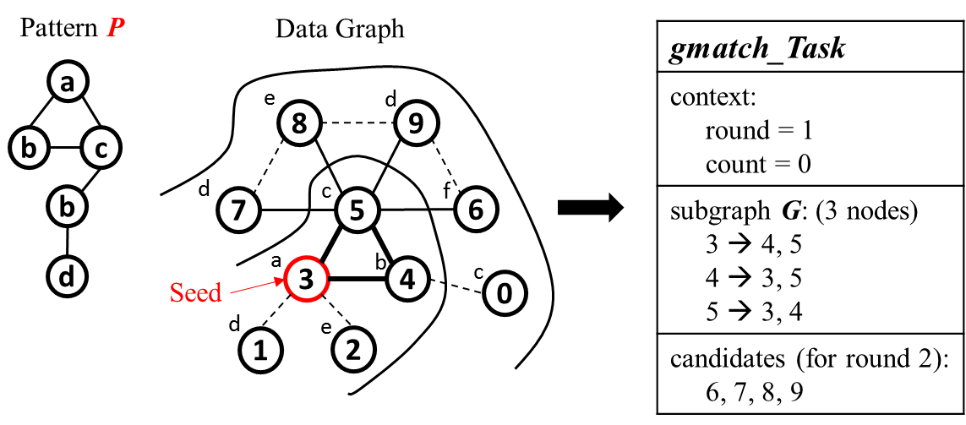
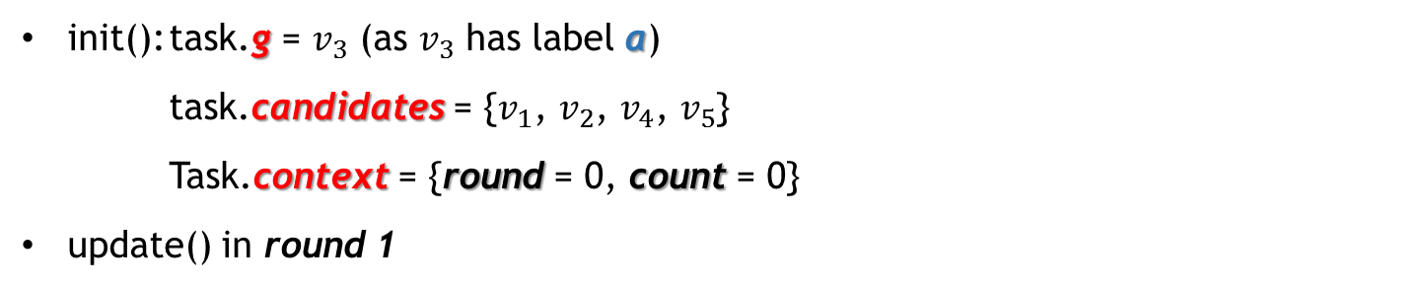
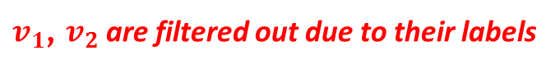
Task Model
Example: graph matching
init(): task.g = $v_{3}$ (as $v_{3}$ has label a)
task.candidates = {$v_{1}$, $v_{2}$, $v_{4}$, $v_{5}$}
Task.context = {round = 0, count = 0}
update() in round 1
$v_{1}$, $v_{2}$ are filtered out due to their labels

Slide 17
Task Model
Task Lifetime
A task can have 4 statuses:
active: is being processed
inactive: wait for vertex-pulling by network
ready: when all candidates are local-accessed
dead: done or pruned
A
I
D
R
Task processing in G-Miner has no barrier among workers or within a worker!

Slide 18
Outlines
Task Model
Task-Pipeline
System Architecture
Load Balancing
G-Miner API
Evaluation

Slide 19
Task Pipeline
Purpose:
To concurrently process the following three major operations in G-Miner:
CPU computation to process the update operation on each task
network communication to pull candidates from remote machines
disk writes/reads to buﬀer those intermediate tasks on local disk
Benefit: the communication and disk I/O overheads can be hidden within the cost of CPU computation (graph mining workload is CPU-intensive)

Slide 20
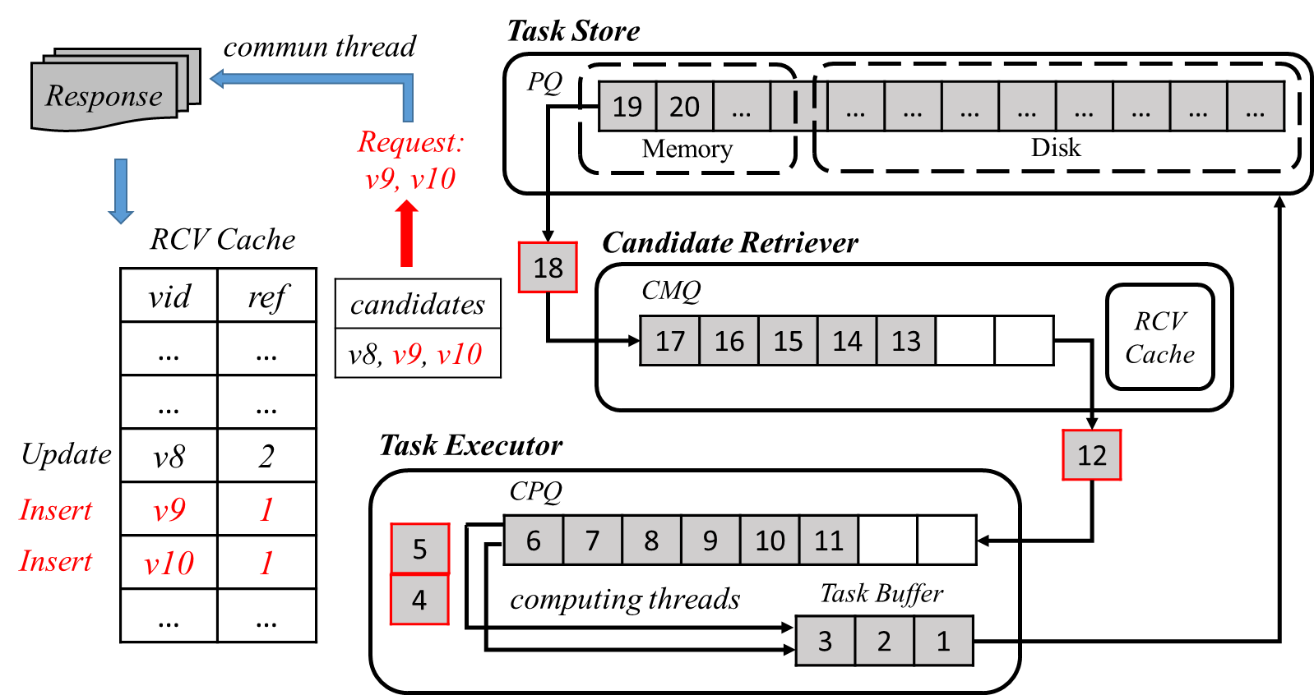
Task Pipeline
The task-pipeline consists of three components:
Task Store
Candidate Retriever
Task Executor

Slide 21
Task Pipeline
The task-pipeline consists of three components:
Task Store
Candidate Retriever
Task Executor
manages all inactive tasks in a disk-extended queue

Slide 22
Task Pipeline
The task-pipeline consists of three components:
Task Store
Candidate Retriever
Task Executor
issue: randomly popping out tasks may cause poor cache hit rate !
A local cache set to avoid repeated vertex pulling

Slide 23
Task Pipeline
The task-pipeline consists of three components:
Task Store
Candidate Retriever
Task Executor
PQ, a locality-sensitive-hashing based priority queue
- To order tasks which have common non-local candidates near by with each other

Slide 24
Task Pipeline
The task-pipeline consists of three components:
Task Store
Candidate Retriever
Task Executor
handles the non-local vertex pulling for inactive tasks in CMQ.

Slide 25
Task Pipeline
The task-pipeline consists of three components:
Task Store
Candidate Retriever
Task Executor
Once all candidates in a task are local accessed, its status will convert into ready.

Slide 26
Task Pipeline
The task-pipeline consists of three components:
Task Store
Candidate Retriever
Task Executor
RCV Cache keeps a reference count for each cached vertex to record the number of ready or active tasks referring to it.

Slide 27
Task Pipeline
The task-pipeline consists of three components:
Task Store
Candidate Retriever
Task Executor
processes the ready tasks in the computation queue (CPQ) in parallel.
To execute the update() for each task in rounds until inactive or dead.

Slide 28
Task Pipeline
The task-pipeline consists of three components:
Task Store
Candidate Retriever
Task Executor
The computing threads insert re-inactive tasks into task buﬀer.
We merge the tasks in task buffer back into PQ once it is full.

Slide 29
Outlines
Task Model
Task-Pipeline
System Architecture
Load Balancing
G-Miner API
Evaluation

Slide 30
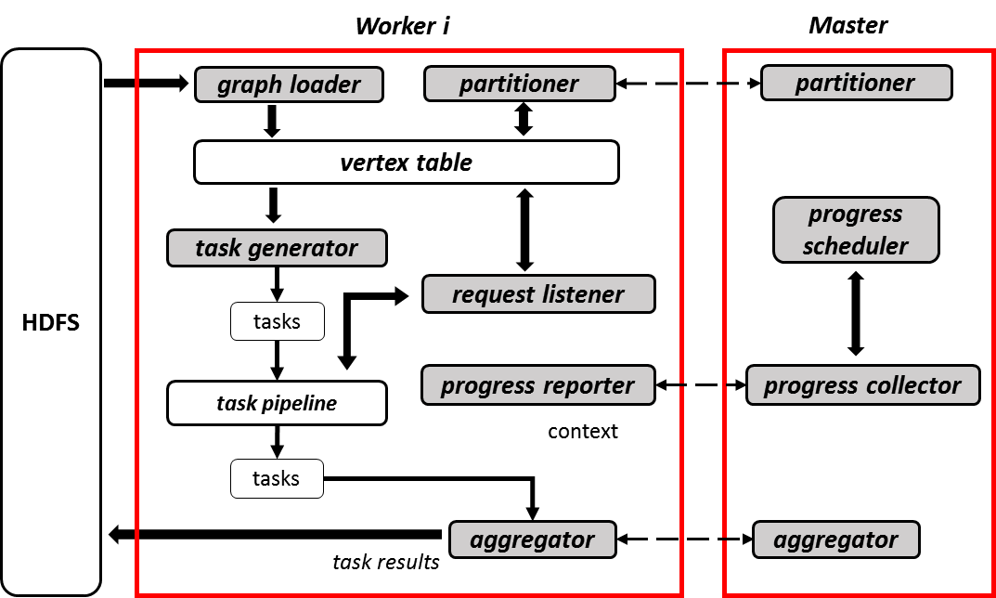
System Architecture
G-Miner adopts a master-slave shared-nothing architecture
Master: graph partitioning strategy, task stealing coordinating, progress scheduling
Workers: handle the tasks processing
aggregator : access the context of each task for global communication and monitoring
e.g. in max-clique finding, a maximum aggregator can be used to record and notify all workers of current maximum size of the clique found globally, which helps local pruning in each worker.

Slide 31
Outlines
Task Model
Task-Pipeline
System Architecture
Load Balancing
G-Miner API
Evaluation

Slide 32
Load Balancing
G-Miner supports both static load balancing (by graph partitioning)
and dynamic load balancing (by task stealing).
Block-based Deterministic Greedy (BDG) Partitioning
step1: Cutting graph into fine-grained blocks
step2: Assigning the blocks to workers according to a deterministic greedy algorithm
Task Stealing
cost model on task
progress monitoring on master
task migration among workers

Slide 33
Outlines
Task Model
Task-Pipeline
System Architecture
Load Balancing
G-Miner API
Evaluation

Slide 34
G-Miner API
To write a G-Miner program, users only need to subclass two predefned classes, Task and Worker, to implement two key virtual functions, init() and update().
An example: Graph Matching

Slide 35
Outlines
Task Model
Task-Pipeline
System Architecture
Load Balancing
G-Miner API
Evaluation

Slide 36
Evaluation
Applications
Triangle Counting (TC)
Maximum Clique Finding (MCF)
Graph Matching (GM)
Community Detection (CD)
Graph Clustering (GC) [based on FocusCO, KDD’14]
Setting
A 15-node physical cluster connected by Gigabit Ethernet
48GB RAM, two 2.0GHz Intel(R) Xeon(R) E5-2620 CPU
Datasets
Dataset | |V| | |E| | Max.Deg | Avg.Deg | |Attr|
Skitter | 1,696,415 | 11,095,298 | 35,455 | 13.081 | -
Orkut | 3,072,441 | 117,184,899 | 33,313 | 76.281 | -
BTC | 164,732,473 | 772,822,094 | 1,637,619 | 4.69 | -
Friendster | 65,608,366 | 1,806,067,135 | 5,214 | 55.056 | -
Tencent | 1,944,589 | 50,133,369 | 456,864 | 55.562 | 122896
DBLP | 1,805,882 | 8,439,133 | 2,134 | 9.346 | 1640

Slide 37
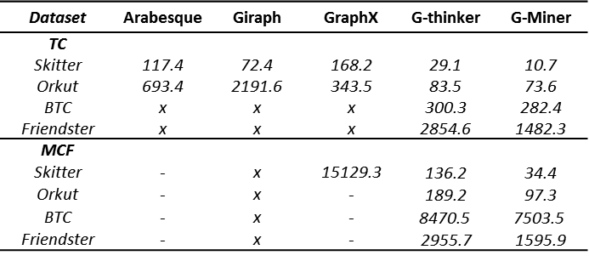
Evaluation
Overall Performance Comparison
Table 1: Elapsed running time in seconds (“-": >24 hours; “x": job failed due to OOM)
- Triangle Counting & Maximum Clique Finding
Significantly outperforms 4 existing distributed graph processing systems

Slide 38
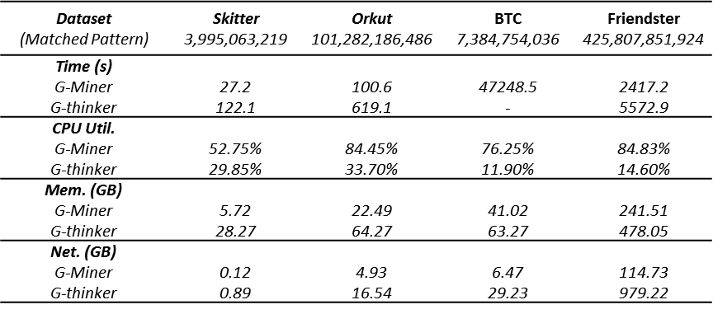
Evaluation
Overall Performance Comparison
Table 2: Performance of G-Miner and G-thinker
- Graph Matching
Obvious advantages over G-thinker on heavy mining job
Better CPU utilization and memory & network efficiency

Slide 39
Evaluation
Resource Utilization
CPU, network and disk I/O utilization of G-thinker, running GM on Friendster
CPU, network and disk I/O utilization of G-Miner, running GM on Friendster

Slide 40
Evaluation
Scalability
McSherry et al. proposed COST to measure the cost of scalability using a distributed system.
COST: the minimum number of cores a parallel/distributed solution used to outperform an optimized single-threaded implementation.
The COST of G-Miner is 3, 3, 2, 2, respectively, for TC, GM on Skitter and Orkut.
Quite low, means excellently scalable.
Figure1: The COST of G-Miner

Slide 41
Conclusion
G-Miner
1. an expressive abstraction and API (task model).
2. outstanding performance achieved by a task-pipeline
removing the barriers
hiding the overheads of network and disk I/O
3. optimizations for system scalability and load balancing.

Slide 42

Thanks
G-Miner
Hongzhi Chen, et al.
Email: hzchen@cse.cuhk.edu.hk
We have released our project on Github
https://github.com/yaobaiwei/GMiner
Husky Data Lab, CSE, CUHK

